Slide 1
Predict before you purchase.
Using Prediction Models to Reduce Defective Inventory Levels.
Slide Show Presentation
Presented by
Maureen Stolberg, CIPM.

Slide 2
The Market Today.
Defective cars often result when there are tampered odometers, mechanical issues the dealer is not able to
address, issues with getting the vehicle title from the seller, or some other unforeseen problem. This is because many auctions do not allow the buyer to inspect the vehicle prior to purchase.
Used Car Resale Industry:
40 million Cars
Total Market Share
Based on these conditions, approximately 12% or 1.2 million vehicles sold at auto auctions are classified as “defective”.
Wholesale Auction Car Resale:
9.9 million Cars
25% market Share
Defective Vehicle Resale:
1.2 million Cars
3% Market Share

Slide 3
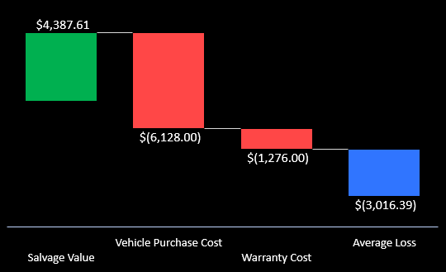
Why does this matter?
Defective car purchases can be costly and hurt the bottom line.
Defective cars are declared unsellable and must be sold at salvage value.
The average loss for each defective car purchased is $3000.00
Total industry loss exceeds by more than $3.6 Billion Dollars.

Slide 4
Being a car expert isn’t enough to identify defective cars.
Defective rates of US Consumer Report-J.D. Power’s Top Most Reliable Cars
Lexus
Lexus achieved the highest defective rate across all 31 brands, despite having remained at the top of JD Power’s Most Reliable list for 6 straight years.

Slide 5
Cosmetic Changes can distract and mislead buyers.
Many times the most important features for determining whether a car is defective are not available.

Slide 6
The Solution.
Predict before you purchase.
Auto dealerships can reduce the likelihood of making bad, costly purchases, at wholesale auctions by using machine learning methods to predict which cars have a higher risk of being classified as defective before an auction takes place.
Reduce defective inventory levels by 87%

Slide 7
The Solution.
Predict before you purchase.
Maximize inventory profit potential.
Make data-driven purchase decisions. Know ahead of time which cars offer the highest profit potential and which cars pose the greatest risk for potential loss.
Average Loss Potential
Average Profit Potential

Slide 8
The Solution.
Predict before you purchase.
Maximize inventory profit potential. Avoid costly mistakes.
Auto dealerships trying to provide the best inventory selection possible can avoid making bad purchases and lower the overall risk of passing on a defective car to their customers resulting in potential savings of $3.1B.
Inventory Loss Reduction Savings
Inventory Loss Reduction
Model Prediction Accuracy

